Slide 1
Pure Machine Learning Approaches for COVID19 Peak Prediction
Anmol Singhal, Harsh Bandhey, Mihir Goyal

Slide 2
Introduction (Problem Statement)
The effect the coronavirus has on the economic, social, industrial, academic etc. aspects of the society has led to many actions by authorities that have significantly affected the lifestyle of people. We have observed a variety of responses to COVID-19 by different countries. The enforcement of a lockdown has proven to be one of the most common and effective strategies. Though the success of the lockdowns is undeniable, the people often have to compromise and this adversely affects their livelihoods and mental health. Our work aims to predict the future of this virus, specifically for India and when it’ll be at its peak of growth. Learning this growth curve in an understandable way would help us estimate when all facets of life would go back to normal.

Slide 3
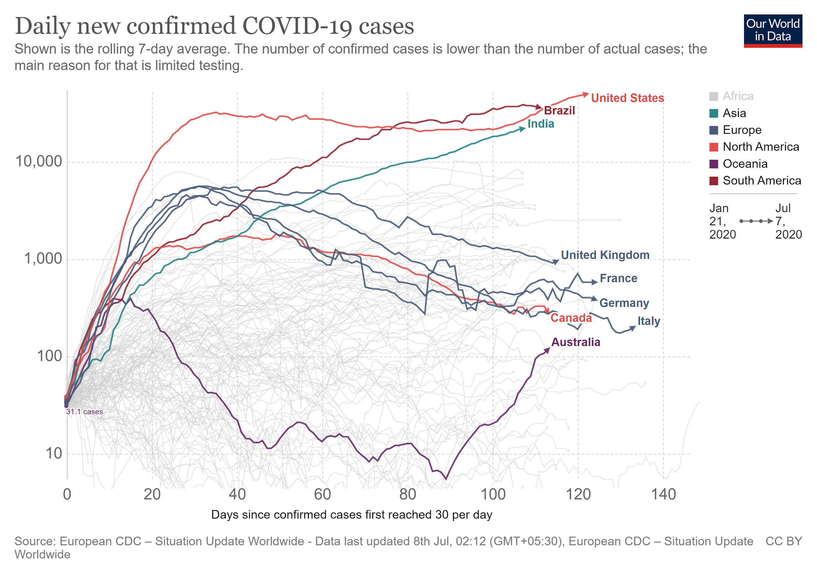
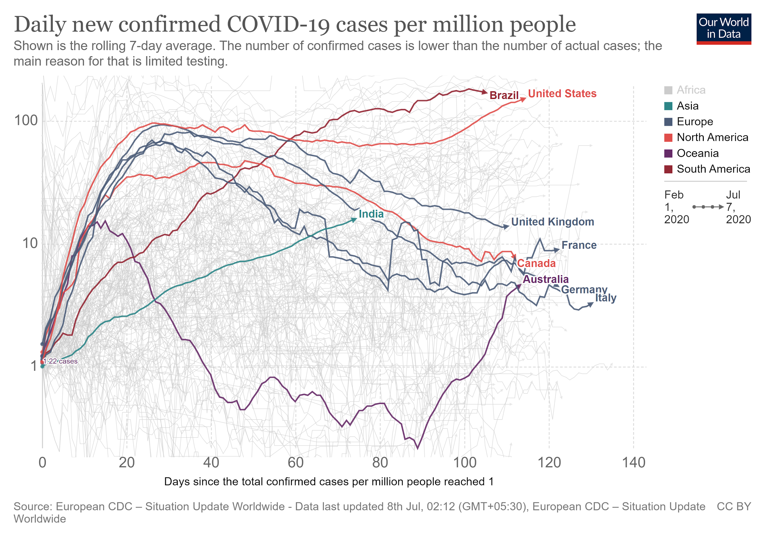
Introduction (Problem Statement)
Using Machine Learning to predict the week when the number new cases reaches is maximum for a county

Slide 4
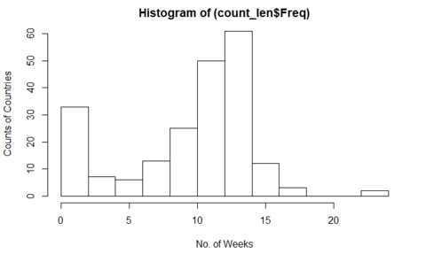
Materials and Method (Data)
Sources: ‘Our World in Data’ (https://ourworldindata.org/coronavirus-source-data),
European Center for Disease Prevention and Control (ECDC).
The establish the following usable features in the data per location (country):
population, population_density, median_age, aged_65_older, aged_70_older, gdp_per_capita, extreme_poverty, cvd_death_rate, diabetes_prevalence, female_smokers, male_smokers, handwashing_facilities, hospital_beds_per_thousand
Among which the following data is sequential
Total_cases, New_cases,
Total_cases_per_million, New_cases_per_million
We filter data for each country on the basis of the following filters.
With Population > 1,00,000
Starting from Total_cases_per_million > 1
And had No of weeks since above > 10
All data is aligned with day 0 as the day when
Total_cases_per_million crosses 1 for the country

Slide 5
Materials and Method (Data)
All data is aligned with day 0 as the day when Total_cases_per_million crosses 1 for the country
Original data has 209 Countries, after filtering 163 Countries are left
Total of 151 Countries are found among which 101 Countries have peaked and 50 Countries including India have yet to peak one week before
Further, we generate 2 features, as moving average with a rolling window of 7 days
moving_average(new_cases)
moving_average(new_cases_per_million)
Further, to predict if the peak is n weeks after this week
Further, we find the peak of each country and take the last (n+1)*7 to (n)7 days previous to peak as sequential features (of length 7, other lengths can also be used) for the LSTM model with the following six features:
Total_cases, New_cases, Total_cases_per_million,New_cases_per_million
moving_average(new_cases), moving_average(new_cases_per_million)
So as to form,
n_countries*7*6 features for training

Slide 6
Materials and Methods (Models)
LSTM Based Sequence Classifiers at N-Weeks ahead
LSTM based classification on New Cases
LSTM with cell units= 28, activation layers='relu'
FC Dense Layer 1, activation='sigmoid'
loss='binary_crossentropy', optimizer= stochastic gradient descent
Learning rate=1e-10, decay=1e-6, momentum=0.9
LSTM based classification on Rate of Change
LSTM units= 28, activation layer='relu'
FC Dense Layer 1, activation='sigmoid'
loss='binary_crossentropy', optimizer= ‘adam’
Learning rate=1e-10, beta_1(decay rate of 1st moment)=0.9, beta_2(decay rate of 2nd moment)=0.999
LSTM based classification on Rate of Change (Regalarized)
Same as above plus
Kernel regularizer l2 1e-5, Bias regularizer l2 1e-5
Recurrent regularizer l2 1e-5

Slide 7
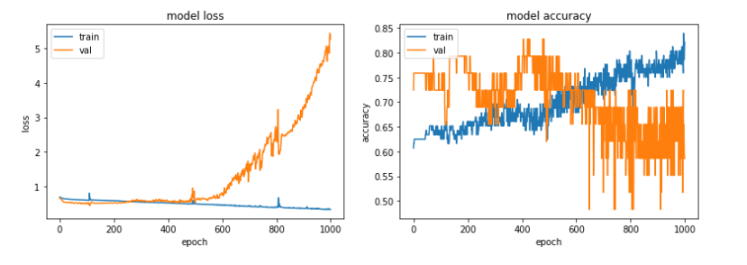
Results (LSTM Based Sequence Classifiers)
Sample Loss and Accuracy Graphs

Slide 8
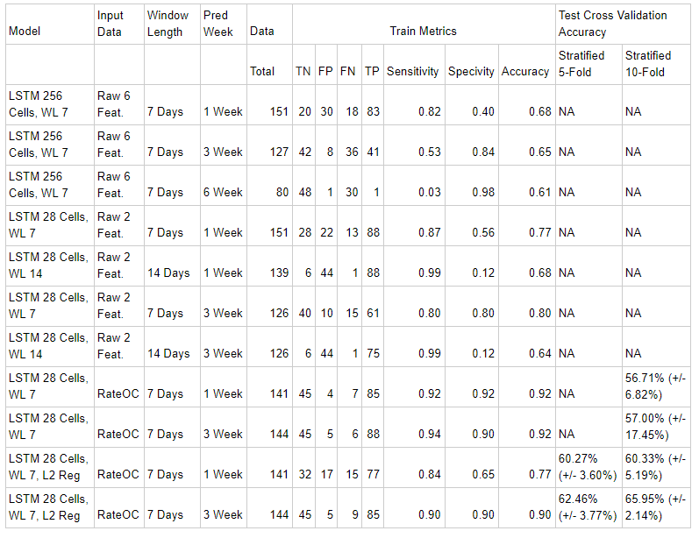
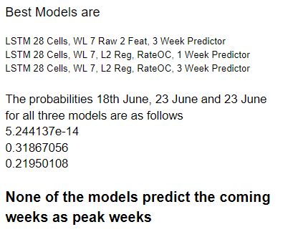
Results (LSTM Based Sequence Classifiers)

